Slide 1
Hardware Acceleration of ARM Cortex Based Computer Vision Systems
REGALADO, GIL MICHAEL

Slide 2
Background of the Study
Human Vision
Important sensory ability
Highest information density
Filter out noise focus on objects of interest

Slide 3
Background of the Study
Artificial Vision
Inspired by nature
visual search applications
Computer Vision
Collection of theory
Obtain information from images
Applied in a wide array of Industries

Slide 4
Background of the Study
Implementation of Computer Vision
Hardware
Compute capability
Software
Efficiency of Algorithms

Slide 5
Background of the Study
OpenCV
Computer Vision Library
Berkeley Software Distribution (BSD) license
Open Source
Intel Research initiative
Intel Russia
Intel’s Performance Library Team

Slide 6
Background of the Study
OpenCV Goals
Advance vision research
Provide open source technology
Optimized code for basic vision infrastructure
Avoiding reinventing the wheel
Integrated Performance Primitives routines to accelerate OpenCV on Intel based processors
Purchase of license
Academic free version

Slide 7
Background of the Study
Competition
ARM architecture
Reduced Instruction Set Computing
ARM Holdings
IP Core business

Slide 8
Background of the Study
RISC
Significant reduction of transistors
Lower cost
Lower operating temperature
Lower power requirements

Slide 9
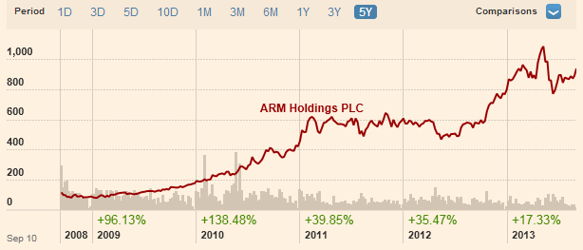
Background of the Study
5 Year period growth
http://markets.ft.com/research/Markets/Tearsheets/Summary?s=ARM:LSE

Slide 10
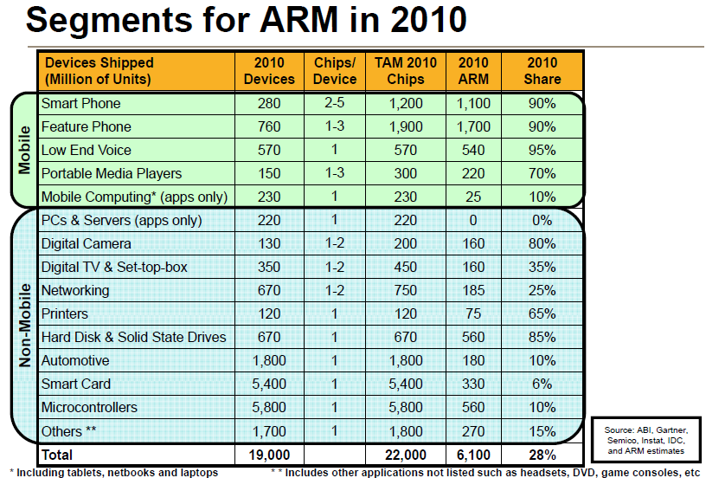

Slide 11
Background of the Study
SoC – System on a Chip
integrates all components of a computer
contain digital, analog, mixed-signal and often radio-frequency functions integrated in one single chip substrate
FPGA
verification of hardware, firmware and software design

Slide 12
Background of the Study
FPGA Cons
General-purpose CPU’s are generally faster for sequential operations
FPGA Pros
Massively parallel operations

Slide 13
Background of the Study
OpenCV
Most operations are parallel
High Bandwidth Operations
Images could be large
Video frame/sec could be high
Operations/Frame a lot

Slide 14
Background of the Study
Zynq-7000 (4th Qtr 2011)
dual ARM Cortex-A9 MPCore
low-power programmable logic
hardened peripheral IP

Slide 15
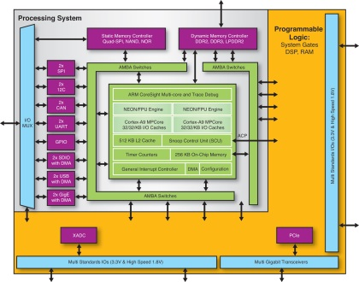

Slide 16
Background of the Study
SocKit 5CSXFC6D6F31C8NES IC (Sept, 2013)
FPGA
Cyclone V
110K LEs, 41509 ALMs
1GB (2x256MBx16) DDR3 SDRAM on FPGA
ARM Hard Processor Core (HPS)
800 MHz, A Dual-Core ARM Cortex™-A9 MPCore™ Processor
1GB (2x256MBx16) DDR3 SDRAM on HPS

Slide 17
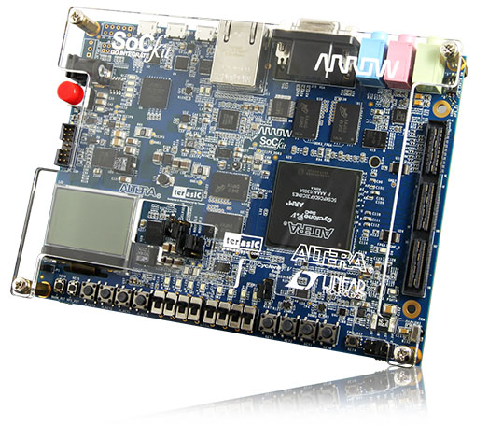

Slide 18
Background of the Study
Challenges Before
CPU Workbench Very expensive
FPGA Workbench Very expensive
CPU and FPGA Interconnect Difficult
Separate boards for CPU and FPGA
Single board Solutions
Still expensive

Slide 19
Background of the Study
Benefits of CPU+FPGA SoC
CPU + FPGA Single Chip Solution
ARM CPU Drives Down Cost
Custom FPGA Logic + CPU now have lower cost
Developer tools available because both are from the same manufacturer
Allows for Development of CPU+FPGA Solutions at lower cost
OpenCV Acceleration

Slide 20
Statement of the Problem
OpenCV
Prevalent on CISC based CPU’s
Headed by Intel
ARM Support of OpenCV
Young
ARM + FPGA Support Very New
This research focuses on Develop ARM+FPGA

Slide 21
Objectives of the Study
To investigate the operation of OpenCV in the field of Face Detection and Recognition implemented in ARM based architectures;
To find opportunities for acceleration of the most common OpenCV functions used in the above application;
To develop such opportunities for acceleration into algorithms implemented in Hardware Description Language (HDL) SystemVerilog;

Slide 22
Objectives of the Study
4. Functional verification of the implemented hardware acceleration IP blocks.
5. To evaluate and compare the performance of the hardware accelerated implementation of OpenCV compared to purely ARM based Implementations;
6. To draw conclusions from the above step to guide in future implementations of hardware acceleration in the field of Computer Vision.

Slide 23
Significance of the Study
acceleration will provide a more efficient and scalable use of the OpenCV
IP blocks for the hardware acceleration can be licensed to other semiconductor companies for implementation not only for ARM based SoCs

Slide 24
Scope and Limitations
There will only be a selected number of OpenCV functions that are going to be accelerated in hardware.
The project implementation will focus on a selected set of hardware development kits that are available to the researcher.

Slide 25
Scope and Limitations
Performance variations may occur due to the different hardware development kits used in the investigation.
Variations on the accuracy and reliability of OpenCV for face detection and recognition will occur on different hardware platforms.

Slide 26
Conceptual Framework
Test Conducted on Pure ARM Board
Cubieboard 2.0

Slide 27
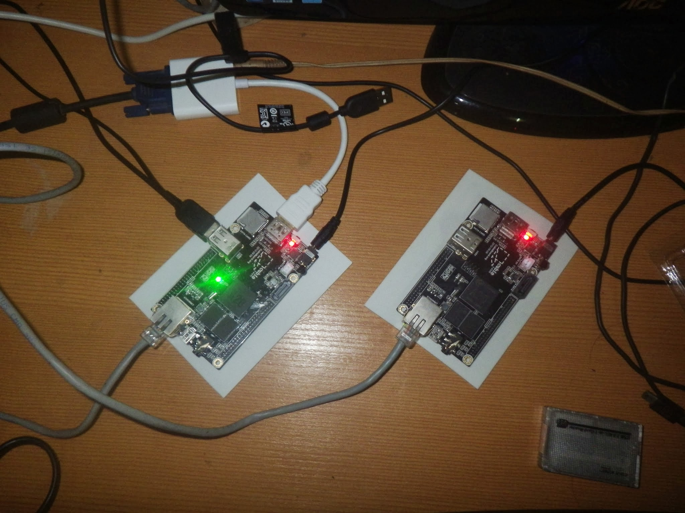

Slide 28
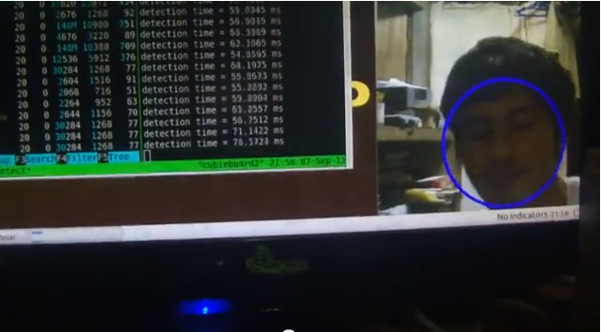
Conceptual Framework
640x480 Rescaling of 1/6 Average detection time 6S at 2ft Awaf from Camera

Slide 29
Conceptual Framework
Chinese based open hardware
ARM® Cortex™-A7 Dual-Core, 1GB DDR3 @960M
ARM® Mali400MP2, Complies with OpenGL ES 2.0/1.1
Very cheap at 60$ each
Very powerful at price range
Very bad documentation/almost none at all
Hardware reference is open source but in Chinese
Community continues to reverse engineer Video/3D/and 2D Acceleration components

Slide 30
Conceptual Framework
Alternative pure ARM Cortex Development Kits
Beagleboard
Raspbery Pi
Same problems
Without access to ARM IP no way of working with advance IC capabilities. Accelerators essentially locked.

Slide 31
Solution:
Develop own Accelerator
Use hybrid platform of FPGA+ARM
Very new in the Market

Slide 32
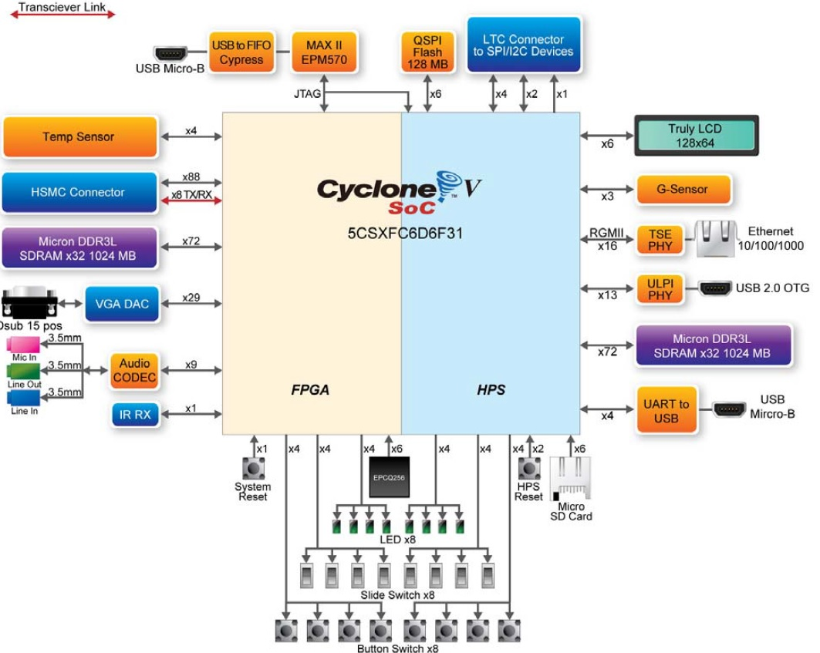
Conceptual Framework

Slide 33
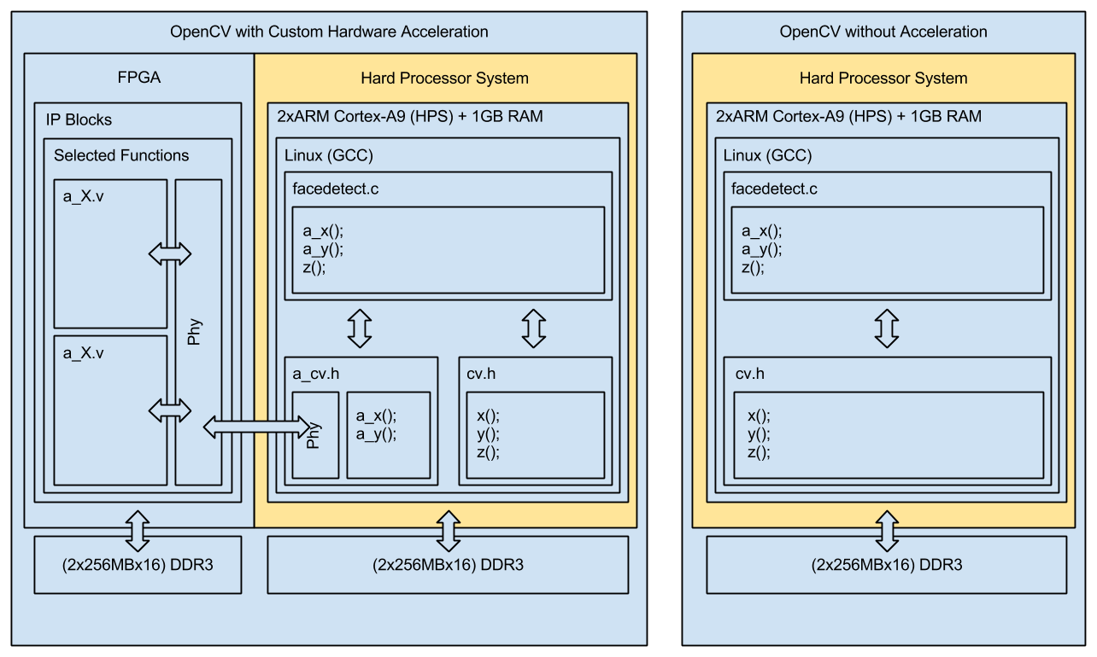
Conceptual Framework

Slide 34
Theoretical Framework
Requires further investigation on the functions of OpenCV
Open Source nature presents huge advantage
Well documented

Slide 35
PROJECT DESIGN AND METHODOLOGY
Tools
Preparation of Development Environment
Installation of OS and Required Tooling
OpenCV
Build OpenCV
Test and evaluation of example code
Analysis
Determine functions that can be optimized
Drafting of algorithms that can be written in HDL
Build
Preparation of Build environment (QSys)
Program custom HDL to FPGA
Analysis
Determine if optimization is correct
Compare results with non optimized OpenCV

Slide 36
PROJECT DESIGN AND METHODOLOGY
Non Hardware Accelerated
cv
facedetect.c
data_input
Refer to Appendix C for Detailed Diagram

Slide 37
PROJECT DESIGN AND METHODOLOGY
Hardware Accelerated Implemenation
cv
facedetect.c
a_cv
function_x.v
data_input
Refer to Appendix C for Detailed Diagram

Slide 38
Questions

